Slide 1
Cards Data Dashboard – Task 4 Interactive Dashboard & Insights

Slide 2
Objective
Analyze credit card data using Power BI
Provide insights on card brands, types, usage, and credit limits
Show trends in card expiry and chip-enabled adoption

Slide 3
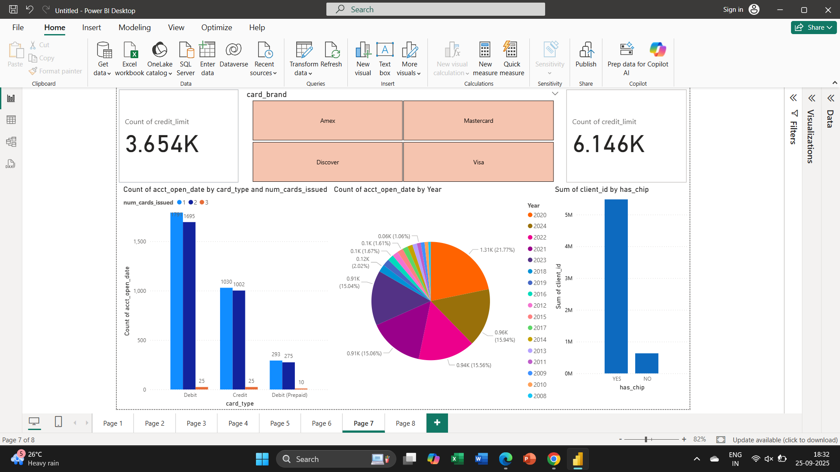
Dashboard Overview

Slide 4
Key Insights – Card Types
- Debit Cards: ~1,791 + 1,695 issued
- Credit Cards: ~1,030 + 1,002 issued
- Debit (Prepaid): ~293 + 275 issued
- Debit cards dominate compared to other types

Slide 5
Yearly Distribution (Expiry)
Highest count in 2020 (21.77%)
Consistent issue trend between 2008–2024
Suggests steady card growth in last decade

Slide 6
Chip-Enabled Insights
- Majority of clients use chip-enabled cards (~5M+)
- Non-chip cards are very low (~under 1M)
- Reflects strong security adoption trend

Slide 7
Conclusion & Recommendations
- Debit cards remain most popular among customers
- Business should focus on chip-enabled features → already widely adopted
- Renewal cycle planning needed around high expiry years (2020–2024)
- Opportunity to promote prepaid & credit card options

